Slide 1
HTTP

Slide 2
Application Programming Interfaces (API)
The API concept predates personal computing and the web. This is as old as computing itself.
API is a publicly available entry point into a system, so the system’s functionality can be used.
In our context, APIs are ways of making payments and related services, available in an easy–to–use way.

Slide 3
APIs, Continued
Web APIs, just like Web Services, leverage the Internet.
Use well-known protocols, such as http and tcp.
Unlike Web Services, which were largely driven by commerce, web APIs were driven both by commerce and social media.

Slide 4
History of Web APIs
Use and adoption grew exponentially since 2000.
Commercial Adoption : eBay, Salesforce, Amazon
Social: Facebook, Instagram, Twitter
Has both coincided with and helped power the rise of cloud computing.

Slide 5
APIs vs. Web Services
APIs, by contrast grew from both commercial and social media needs.
Are easier to adopt.
Support a variety of languages.
Supports XML and JSON. JSON is lighter and is well-suited for Mobile devices.

Slide 6
Web APIs
Web APIs are simple to use, easy to experiment and work with.
Mobile apps use Web APIs to integrate with providers.
Simple and granular APIs make for better adoption. Give great freedom for app developers to use, so their needs are met.
Use RESTful interfaces.

Slide 7
HTTP
HTTP stands for Hypertext Transfer Protocol. It's a stateless, application-layer protocol for communicating between distributed systems, and is the foundation of the modern web. As a web api developer, we all must have a strong understanding of this protocol
http://www.w3.org/Protocols/rfc2616/rfc2616

Slide 8
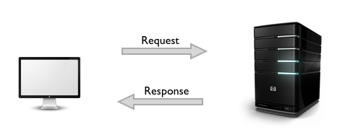
HTTP
HTTP is a stateless protocol. The communication usually takes place over TCP/IP, but any reliable transport can be used. The default port for TCP/IP is 80

Slide 9
HTTP/1.1
Communication between a host and a client occurs, via a request/response pair. The client initiates an HTTP request message, which is serviced through a HTTP response message in return
The current version of the protocol is HTTP/1.1, which adds a few extra features
persistent connections
chunked transfer-coding
fine-grained caching headers.

Slide 10
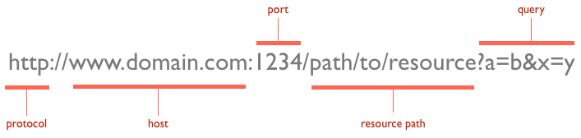
URLs
At the heart of web communications is the request message, which are sent via Uniform Resource Locators (URLs).

Slide 11
Verbs
GET: fetch an existing resource. The URL contains all the necessary information the server needs to locate and return the resource.
POST: create a new resource. POST requests usually carry a payload that specifies the data for the new resource.
PUT: update an existing resource. The payload may contain the updated data for the resource.
DELETE: delete an existing resource
Notes:
There are also web debugging proxies, like Fiddler on Windows and Charles Proxy for OSX.
URLs reveal the identity of the particular host with which we want to communicate, but the action that should be performed on the host is specified via HTTP verbs. Of course, there are several actions that a client would like the host to perform. HTTP has formalized on a few that capture the essentials that are universally applicable for all kinds of applications.
The above four verbs are the most popular, and most tools and frameworks explicitly expose these request verbs. PUT and DELETE are sometimes considered specialized versions of the POST verb, and they may be packaged as POSTrequests with the payload containing the exact action: create, update or delete.

Slide 12
Verbs, cont.
HEAD: this is similar to GET, but without the message body. It's used to retrieve the server headers for a particular resource, generally to check if the resource has changed, via timestamps.
TRACE: used to retrieve the hops that a request takes to round trip from the server. Each intermediate proxy or gateway would inject its IP or DNS name into the Via header field. This can be used for diagnostic purposes.
OPTIONS: used to retrieve the server capabilities. On the client-side, it can be used to modify the request based on what the server can support

Slide 13
Status Codes
With URLs and verbs, the client can initiate requests to the server. In return, the server responds with status codes and message payloads. The status code is important and tells the client how to interpret the server response

Slide 14
1xx: Informational Messages
All HTTP/1.1 clients are required to accept the Transfer-Encoding header.
This class of codes was introduced in HTTP/1.1 and is purely provisional. The server can send a Expect: 100-continue message, telling the client to continue sending the remainder of the request, or ignore if it has already sent it. HTTP/1.0 clients are supposed to ignore this header

Slide 15
2xx: Successful
This tells the client that the request was successfully processed. The most common code is 200 OK. For a GET request, the server sends the resource in the message body. There are other less frequently used codes:
202 Accepted: the request was accepted but may not include the resource in the response. This is useful for async processing on the server side. The server may choose to send information for monitoring.
204 No Content: there is no message body in the response.
205 Reset Content: indicates to the client to reset its document view.
206 Partial Content: indicates that the response only contains partial content. Additional headers indicate the exact range and content expiration information

Slide 16
3xx: Redirection
404 indicates that the resource is invalid and does not exist on the server.
This requires the client to take additional action. The most common use-case is to jump to a different URL in order to fetch the resource.
301 Moved Permanently: the resource is now located at a new URL.
303 See Other: the resource is temporarily located at a new URL. TheLocation response header contains the temporary URL.
304 Not Modified: the server has determined that the resource has not changed and the client should use its cached copy. This relies on the fact that the client is sending ETag (Enttity Tag) information that is a hash of the content. The server compares this with its own computed ETag to check for modifications

Slide 17
4xx: Client Error
These codes are used when the server thinks that the client is at fault, either by requesting an invalid resource or making a bad request. The most popular code in this class is 404 Not Found, which I think everyone will identify with. 404 indicates that the resource is invalid and does not exist on the server. The other codes in this class include:
400 Bad Request: the request was malformed.
401 Unauthorized: request requires authentication. The client can repeat the request with the Authorization header. If the client already included theAuthorization header, then the credentials were wrong.
403 Forbidden: server has denied access to the resource.
405 Method Not Allowed: invalid HTTP verb used in the request line, or the server does not support that verb.
409 Conflict: the server could not complete the request because the client is trying to modify a resource that is newer than the client's timestamp. Conflicts arise mostly for PUT requests during collaborative edits on a resource

Slide 18
5xx: Server Error
This class of codes are used to indicate a server failure while processing the request. The most commonly used error code is 500 Internal Server Error. The others in this class are:
501 Not Implemented: the server does not yet support the requested functionality.
503 Service Unavailable: this could happen if an internal system on the server has failed or the server is overloaded. Typically, the server won't even respond and the request will timeout

Slide 19

Request / Response
URLs, verbs and status codes make up the fundamental pieces of an HTTP request/response pair

Slide 20
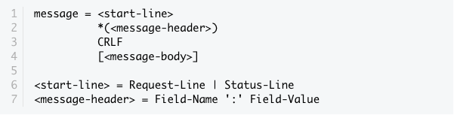
The HTTP specification states that a request or response message has the following generic structure

Slide 21
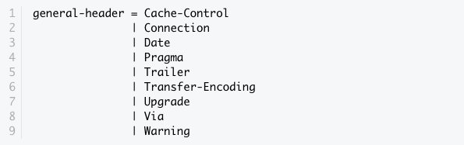
General Headers
General Headers can be shared between request and response

Slide 22
General Headers
The status code is important and tells the client how to interpret the server response.
Via header is used in a TRACE message and updated by all intermittent proxies and gateways
Pragma is considered a custom header and may be used to include implementation-specific headers. The most commonly used pragma-directive is Pragma: no-cache, which really is Cache-Control: no-cache under HTTP/1.1. This will be covered in Part 2 of the HTTP session.
The Date header field is used to timestamp the request/response message
Upgrade is used to switch protocols and allow a smooth transition to a newer protocol.
Transfer-Encoding is generally used to break the response into smaller parts with the Transfer-Encoding: chunked value. This is a new header in HTTP/1.1 and allows for streaming of response to the client instead of one big payload

Slide 23
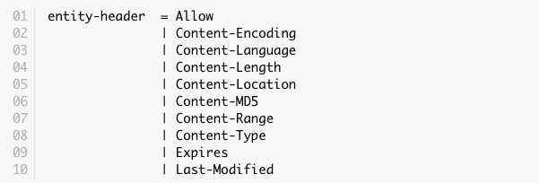
Entity Headers
Request and Response messages may also include entity headers to provide meta-information about the the content (aka Message Body or Entity). These headers include:

Slide 24
Entity Headers
All of the Content- prefixed headers provide information about the structure, encoding and size of the message body. Some of these headers need to be present if the entity is part of the message.
The Expires header indicates a timestamp of when the entity expires. Interestingly, a "never expires" entity is sent with a timestamp of one year into the future.
The Last-Modified header indicates the last modification timestamp for the entity

Slide 25
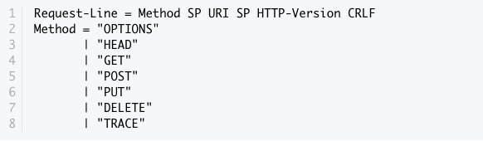
Request Format
The request message has the same generic structure as above, except for the request line which looks like
Notes:
SP is the space separator between the tokens. HTTP-Version is specified as"HTTP/1.1" and then followed by a new line

Slide 26
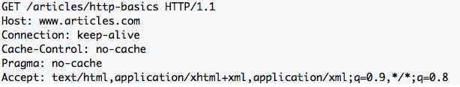
Example
Note the request line followed by many request headers. The Host header is mandatory for HTTP/1.1 clients. GET requests do not have a message body, but POST requests can contain the post data in the body.

Slide 27
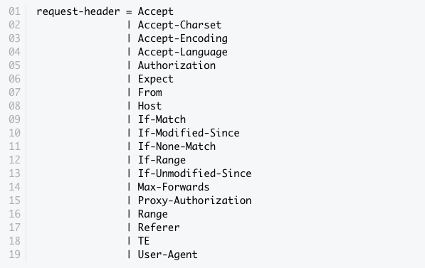
Request Headers

Slide 28
Request Headers
The Accept prefixed headers indicate the acceptable media-types, languages and character sets on the client.
From, Host, Referer and User-Agent identify details about the client that initiated the request.
The If- prefixed headers are used to make a request more conditional, and the server returns the resource only if the condition matches. Otherwise, it returns a 304 Not Modified. The condition can be based on a timestamp or an ETag (a hash of the entity)

Slide 29
User-Agent
Software product used by original client
<field> = User-Agent: <product>
<product> = <word> [/<version>]
<version> = <word>
Ex.
User-Agent: IBM WebExplorer DLL /v960311

Slide 30
Modified-Since:
Used with GET to make a conditional GET
if requested document has not been modified since specified date a Modified 304 header is sent back to client instead of document
client can then display cached version

Slide 31
Authorization:
For Password and authentication schemes
Ex.
Authorization: Basic (base64 encoded username:password pair)
Authorization: user fred:mypassword
Authorization: kerberos kerberosparameters
Authorization: Bearer rRR0GnTudjuUUGaSt0n

Slide 32
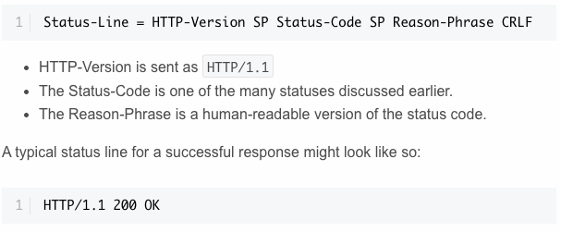
Response Format
The response format is similar to the request message, except for the status line and headers. The status line has the following structure

Slide 33
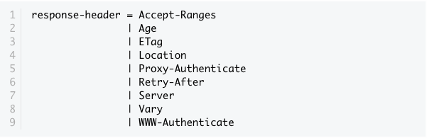
Response Format
Age is the time in seconds since the message was generated on the server.
ETag is the MD5 hash of the entity and used to check for modifications.
Location is used when sending a redirection and contains the new URL.
Server identifies the server generating the message.

Slide 34
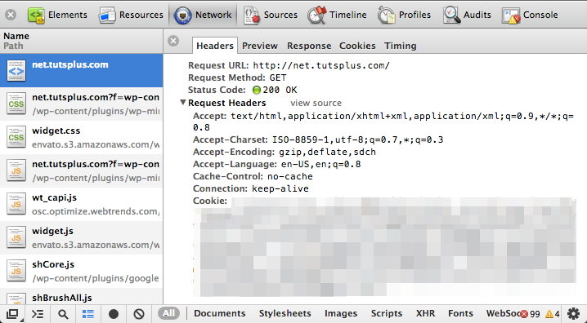
Chrome/Webkit Inspector

Slide 35
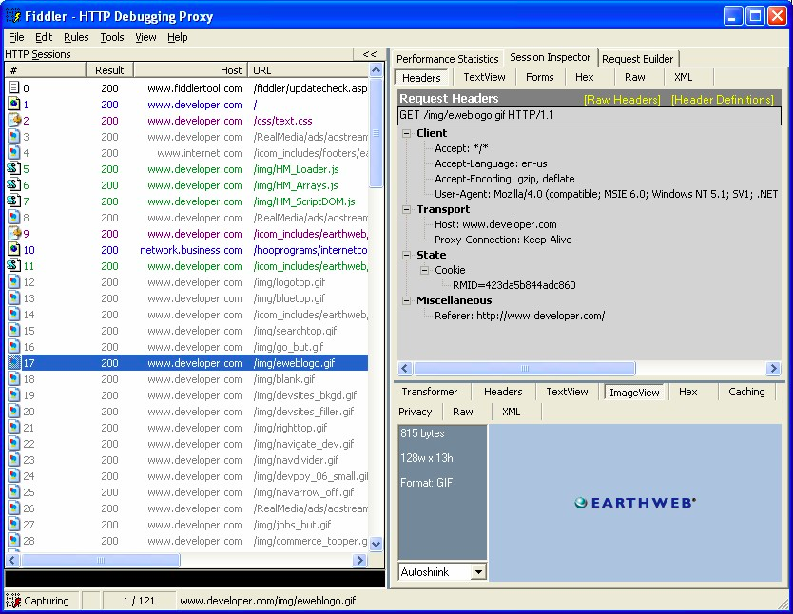
Fiddler

Slide 36
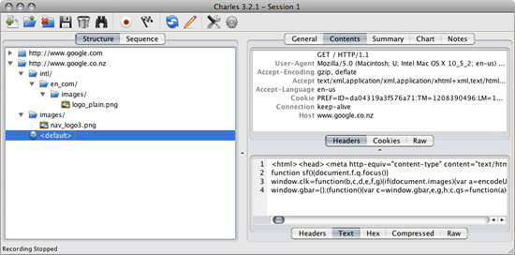
Charles Proxy

Slide 37
Node.JS
ExpressJS provides a simple API for doing just that. We won't cover the details of the API. Instead, we will provide links to the detailed documentation on ExpressJS guide

Slide 38
ExpressJS Request
req.body: get the request body
req.query: get the query fragment of the URL
req.originalUrl
req.host: reads the Host header field
req.accepts: read the acceptable MIME-types on the client side
req.get or req.header: read any header field passed as an argument

Slide 39
ExpressJS Response
res.status: set an explicit status code
res.set: set a specific response header
res.send: send HTML, JSON or an octet-stream
res.sendFile: transfer a file to the client
res.render: render an express view template
res.redirect: redirect to a different route (e.g. 302)

Slide 40


cloud

Slide 46
HTTP Connections
A connection must be established between the client and server before they can communicate with each other, and HTTP uses the reliable TCP transport protocol to make this connection. By default, web traffic uses TCP port 80. A TCP stream is broken into IP packets, and it ensures that those packets always arrive in the correct order without fail. HTTP is an application layer protocol over TCP, which is over IP

Slide 47

HTTPS
HTTPS is a secure version of HTTP, inserting an additional layer between HTTP and TCP called TLS or SSL (Transport Layer Security or Secure Sockets Layer, respectively)

Slide 48

HTTP Connection
An HTTP connection is identified by <source-IP, source-port> and<destination-IP, destination-port>. On a client, an HTTP application is identified by a <IP, port> tuple. Establishing a connection between two endpoints is a multi-step process and involves the following:

Slide 49
HTTP Connection, cont.
resolve IP address from host name via DNS
establish a connection with the server
send a request
wait for a response
close connection

Slide 50
HTTP Connections
In HTTP/1.0, all connections were closed after a single transaction. So, if a client wanted to request three separate images from the same server, it made three separate connections to the remote host. As you can see from the above diagram, this can introduce lot of network delays, resulting in a sub-optimal user experience.
To reduce connection-establishment delays, HTTP/1.1 introduced persistent connections, long-lived connections that stay open until the client closes them. Persistent connections are default in HTTP/1.1, and making a single transaction connection requires the client to set the Connection: close request header. This tells the server to close the connection after sending the response

Slide 51
Parallel Connections
In addition to persistent connections, browsers/clients also employ a technique, called parallel connections, to minimize network delays. The age-old concept of parallel connections involves creating a pool of connections (generally capped at six connections). If there are six assets that the client needs to download from a website, the client makes six parallel connections to download those assets, resulting in a faster turnaround

Slide 52
HTTP Servers
The server mostly listens for incoming connections and processes them when it receives a request. The operations involve:
establishing a socket to start listening on port 80 (or some other port)
receiving the request and parsing the message
processing the response
setting response headers
sending the response to the client
close the connection if a Connection: close request header was found

Slide 53
Identification
It is almost mandatory to know who connects to a server for tracking an app's or site's usage and the general interaction patterns of users. The premise of identification is to tailor the response in order to provide a personalized experience; naturally, the server must know who a user is in order to provide that functionality

Slide 54
Identification
Request headers: From, Referer, User-Agent - We saw these headers inPart 1.
Client-IP - the IP address of the client
Fat Urls - storing state of the current user by modifying the URL and redirecting to a different URL on each click; each click essentially accumulates state.
Cookies - the most popular and non-intrusive approach

Slide 55
Cookies
Cookies allow the server to attach arbitrary information for outgoing responses via the Set-Cookie response header. A cookie is set with one or more name=value pairs separated by semicolon (;),
as in Set-Cookie: session-id=12345ABC; username=nettuts.

Slide 56
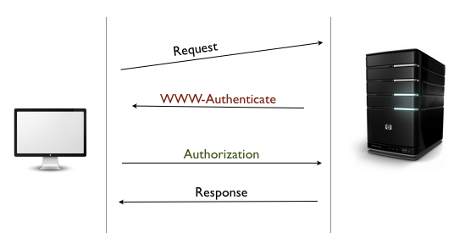
Basic Auth
HTTP does support a rudimentary form of authentication called Basic Authentication, as well as the more secure Digest Authentication

Slide 57
Basic Auth
In Basic Authentication, the server initially denies the client's request with a WWW-Authenticate response header and a 401 Unauthorized status code.
On seeing this header, the browser displays a login dialog, prompting for a username and password. This information is sent in a base-64 encoded format in the Authentication request header.
The server can now validate the request and allow access if the credentials are valid.
Some servers might also send an Authentication-Info header containing additional authentication details

Slide 58
Proxy Auth
A corollary to Basic-Authentication is Proxy Authentication. Instead of a web server, the authentication challenge is requested by an intermediate proxy. The proxy sends a Proxy-Authenticate header with a 407 Unauthorized status code. In return, the client is supposed to send the credentials via the Proxy-Authorization request header.

Slide 59
Digest Auth
Digest Authentication is similar to Basic and uses the same handshake technique with the WWW-Authenticate and Authorization headers, but Digest uses a more secure hashing function to encrypt the username and password (commonly with MD5 or KD digest functions).
Although Digest Authentication is supposed to be more secure than Basic, websites typically use Basic Authentication because of its simplicity. To mitigate the security concerns, Basic Auth is used in conjunction with SSL

Slide 60
Secure HTTP
SSL uses a powerful form of encryption using RSA and public-key cryptography. Because secure transactions are so important on the web, a ubiquitous standards-based Public-Key Infrastructure (PKI)

Slide 61
Certificates
Certificates (or "certs") are issued by a Certificate Authority (CA) and vouch for your identity on the web. The CAs are the guardians of the PKI. The most common form of certificates is the X. the certificate issuer
the algorithm used for the certificate
the subject name or organization for whom this cert is created
the public key information for the subject
the Certification Authority Signature, using the specified signing algorithm

Slide 62
Certificates, cont.
When a client makes a request over HTTPS, it first tries to locate a certificate on the server. If the cert is found, it attempts to verify it against its known list of CAs. If its not one of the listed CAs, it might show a dialog to the user warning about the website's certificate.
Once the certificate is verified, the SSL handshake is complete and secure transmission is in effect

Slide 63
HTTP Caching
It is generally agreed that doing the same work twice is wasteful. This is the guiding principle around the concept of HTTP caching, a fundamental pillar of the HTTP Network Infrastructure. Because most of the operations are over a network, a cache helps save time, cost and bandwidth, as well as provide an improved experience on the web

Slide 64
HTTP Caching
Caches are used at several places in the network infrastructure, from the browser to the origin server. Depending on where it is located, a cache can be categorized as:
Private: within a browser, caches usernames, passwords, URLs, browsing history and web content. They are generally small and specific to a user.
Public: deployed as caching proxies between the server and client. These are much larger because they serve multiple users. A common practice is to keep multiple caching proxies between the client and the origin-server. This helps to serve frequently accessed content, while still allowing a trip to the server for infrequently needed content

Slide 65
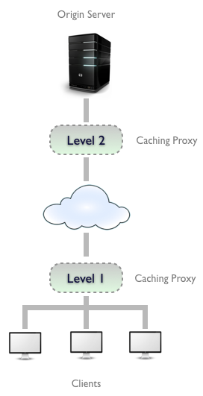
Cache
Regardless of where a cache is located, the process of maintaining a cache is quite similar:
Receive request message.
Parse the URL and headers.
Lookup a local copy; otherwise, fetch and store locally
Do a freshness check to determine the age of the content in the cache; make a request to refresh the content only if necessary.
Create the response from the cached body and updated headers.
Send the response back to client.
Optionally, log the transaction

Slide 66
Cache Response Headers
Of course, the server is responsible for always responding with the correct headers and responses. If a document hasn't changed, the server should respond with a 304 Not Modified.
If the cached copy has expired, it should generate a new response with updated response headers and return with a 200 OK.
If the resource is deleted, it should come back with 404 Not Found.
These responses help tune the cache and ensure that stale content is not kept for too long

Slide 67
Cache Control Headers
Keeping the content fresh and up-to-date is one of the primary responsibilities of the cache.
To keep the cached copy consistent with the server, HTTP provides some simple mechanisms, namely Document Expiration and Server Revalidation

Slide 68
Documentation Expiration
HTTP allows an origin-server to attach an expiration date to each document using the Cache-Control and Expires response headers. This helps the client and other cache servers know how long a document is valid and fresh. The cache can serve the copy as long as the age of the document is within the expiration date. Once a document expires, the cache must check with the server for a newer copy and update its local copy accordingly

Slide 69
Documentation Expiration
Expires is an older HTTP/1.0 response header that specifies the value as an absolute date. This is only useful if the server clocks are in sync with the client, which is a terrible assumption to make.
This header is less useful compared to the newer Cache-Control: max-age=<s> header introduced in HTTP/1.1.
Here, max-age is a relative age, specified in seconds, from the time the response was created. Thus if a document should expire after one day, the expiration header should be
Cache-Control: max-age=86400

Slide 70
Server Revalidation
Once a cached document expires, the cache must revalidate with the server to check if the document has changed. This is called server revalidation and serves as a querying mechanism for the stale-ness of a document. Just because a cached copy has expired doesn't mean that the server actually has newer content

Slide 71
Server Revalidation
The revalidation step can be accomplished with two kinds of request-headers: If-Modified-Since and If-None-Match. The former is for date-based validation while the latter uses Entity-Tags (ETags), a hash of the content
These headers use date or ETag values obtained from a previous server response
In case of If-Modified-Since, the Last-Modified response header is used; for If-None-Match, it is the ETag response header.

Slide 72
Controlling Cache
The validity period for a document should be defined by the server generating the document. If it's a newspaper website, the homepage should expire after a day (or sometimes even every hour!). HTTP provides the Cache-Control and Expires response headers to set the expiration on documents. As mentioned earlier, Expires is based on absolute dates and not a reliable solution for controlling cache.

Slide 73
Cache-Control
The Cache-Control header is far more useful and has a few different values to constrain how clients should be caching the response:
Cache-Control: no-cache: the client is allowed to store the document; however, it must revalidate with the server on every request. There is a HTTP/1.0 compatibility header called Pragma: no-cache, which works the same way.
Cache-Control: no-store: this is a stronger directive to the client to not store the document at all.
Cache-Control: must-revalidate: this tells the client to bypass its freshness calculation and always revalidate with the server. It is not allowed to serve the cached response in case the server is unavailable.
Cache-Control: max-age: this sets a relative expiration time (in seconds) from the time the response is generated

Slide 74
Cache-Control Client
Cachability is not just limited to the server. It can also be specified from the client. This allows the client to impose constraints on what it is willing to accept. This is possible via the same Cache-Control header, albeit with a few different values:
Cache-Control: min-fresh=<s>: the document must be fresh for at least <s>seconds.
Cache-Control: max-stale or Cache-Control: max-stale=<s>: the document cannot be served from the cache if it has been stale for longer than <s>seconds.
Cache-Control: max-age=<s>: the cache cannot return a document that has been cached longer than <s> seconds.
Cache-Control: no-cache or Pragma: no-cache: the client will not accept a cached resource unless it has been revalidated

Slide 75
HTTP/2
Multiplexing
Header Compression
Binary Protocol (HTTP/1.1 is text)
Encryption Required
Server Push (Server can push resources uninitiated)

Slide 76
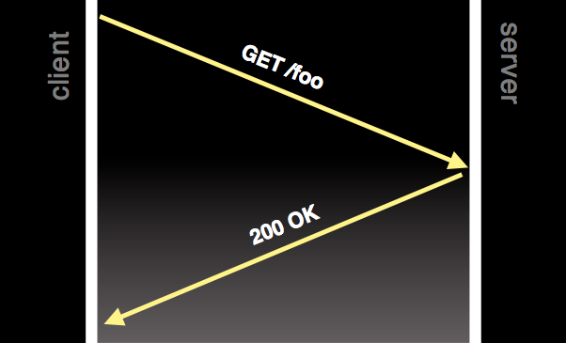
HTTP/1.0
1 request per tcp connection

Slide 77
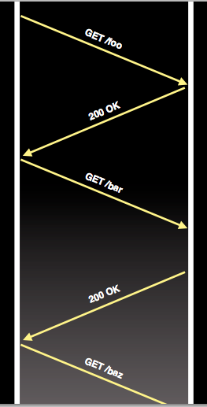
HTTP/1.0 with KeepAlive
Ability to re-use connection
Still block – download has to complete before next request

Slide 78
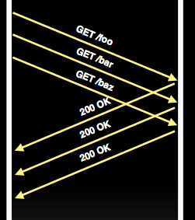
HTTP/1.1 with Pipelining
Multiple ordered requests

Slide 79
HTTP/1.1
HTTP/1.1 connections can request a single object at a time
But there are many objects in a webpage and some have dependencies
What happens if I want to parallelize downloads?
Need to open multiple TCP connections (usually max 6)
What happens if a less important object is downloaded first?
This is a problem
Head Of Line Blocking where a large unimportant file ‘clogs up’ the connection

Slide 80
Domain Sharding
Server
Create More Domains!
Server
Client
Server
Server

Slide 81
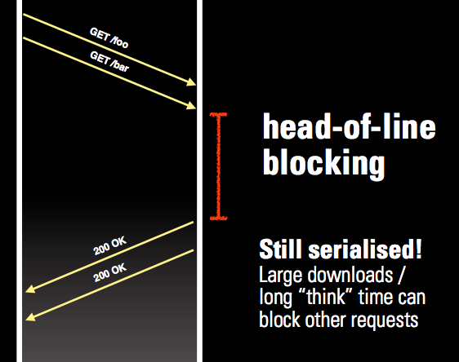
HTTP/1.1 with Pipelining

Slide 82
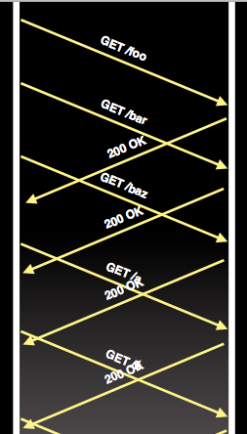
SPDY
One connection
Many requests
Prioritization
Out of order
interleaved

Slide 83
Multiplexing
Single TCP connection per domain
Up to 100 ‘Streams’ per TCP connection
Server
Client

Slide 84
SPDY
One connection
Many requests
Prioritization
Out of order
interleaved

Slide 85
HTTP Header
Very similar
Request Uri
User-Agent
Cookies
Referer

Slide 87
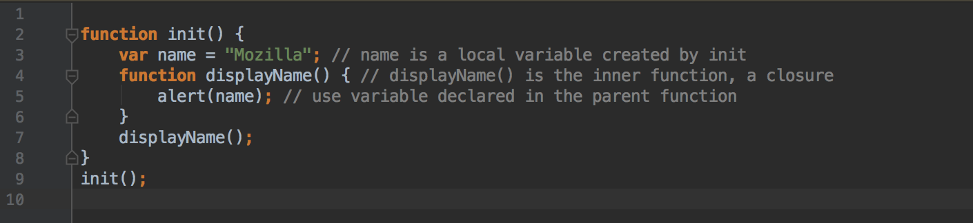

Closure
Notes:
init() creates a local variable name and then a function called displayName(). displayName() is an inner function that is defined inside init() and is only available within the body of that function. displayName() has no local variables of its own, however it has access to the variables of outer functions and so can use the variable name declared in the parent function.

Slide 88
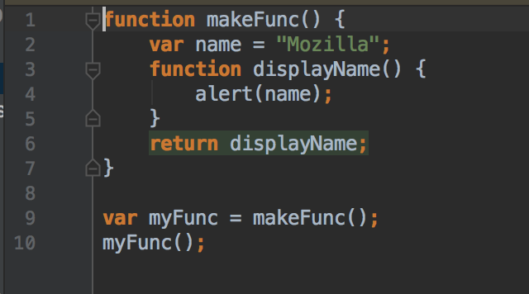
Closure
Notes:
If you run this code it will have exactly the same effect as the previous init() example: the string "Mozilla" will be displayed in a JavaScript alert box. What's different — and interesting — is that the displayName() inner function was returned from the outer function before being executed.
That the code still works may seem unintuitive. In languages without lexical closures, the local variables within a function only exist for the duration of that function's execution.
Once makeFunc() has finished executing, it is reasonable to expect that the name variable will no longer be accessible. Since the code still works as expected, this is obviously not the case in JavaScript.
The reason is that functions in JavaScript form closures. A closure is the combination of a function and the lexical environment (or simply "environment") within which that function was declared. The environment consists of any local variables that were in-scope at the time that the closure was created. In this case, myFunc is a reference to the instance of the function displayName created when makeFunc is run. The instance of displayName maintains a reference to its lexical environment, within which the variable name exists. Hence when invoking myFunc, the variable name remains available for use and "Mozilla" is passed to alert.

Slide 89
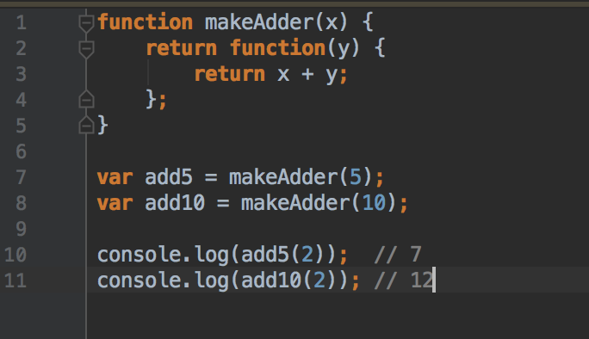
Closure
Notes:
In this example, we have defined a function makeAdder(x) which takes a single argument x and returns a new function. The function it returns takes a single argument y, and returns the sum of x and y.
In essence, makeAdder is a function factory — it creates functions which can add a specific value to their argument. In the above example we use our function factory to create two new functions — one that adds 5 to its argument, and one that adds 10.
add5 and add10 are both closures. They share the same function body definition, but store different environments. In add5's environment, x is 5. As far as add10 is concerned, x is 10.

Slide 90
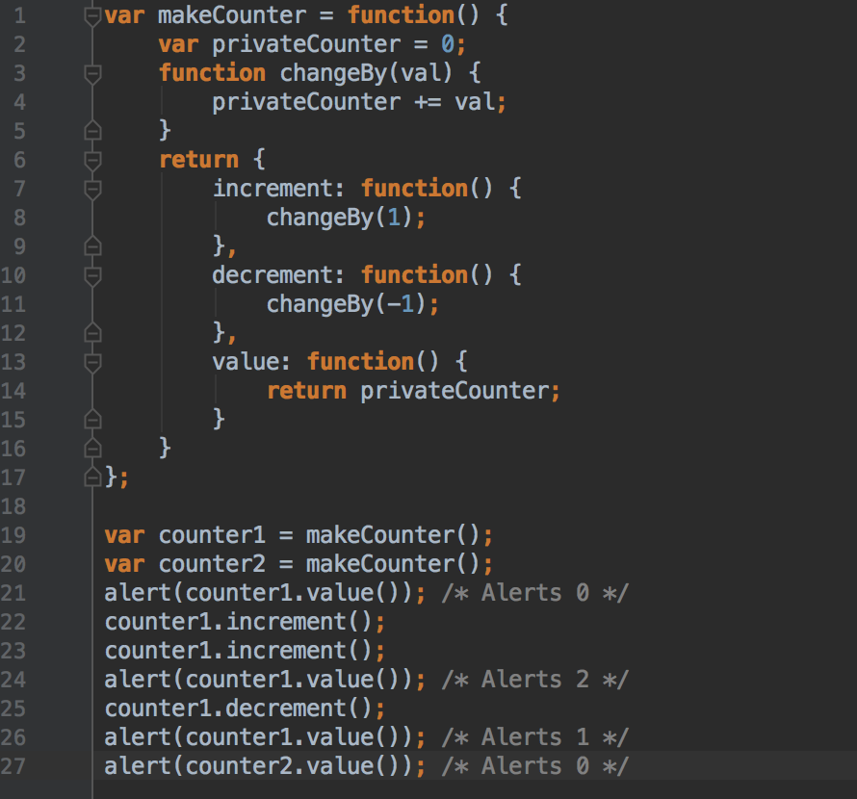
Closure
Notes:
Notice how each of the two counters maintains its independence from the other. Its environment during the call of the makeCounter() function is different each time. The closure variable privateCounter contains a different instance each time.
Using closures in this way provides a number of benefits that are normally associated with object oriented programming, in particular data hiding and encapsulation.

Slide 91
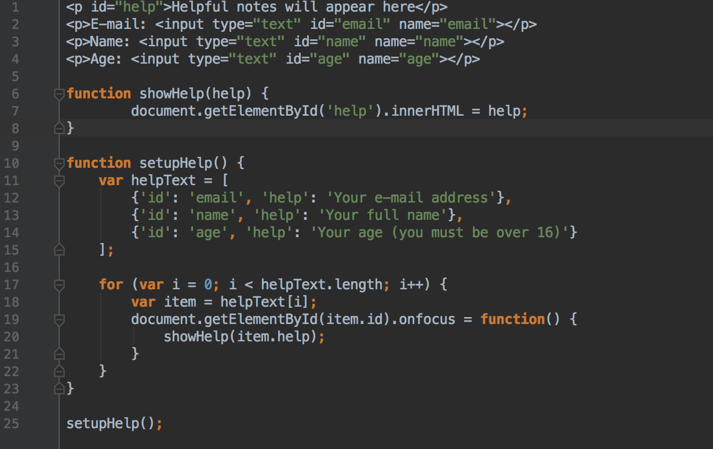
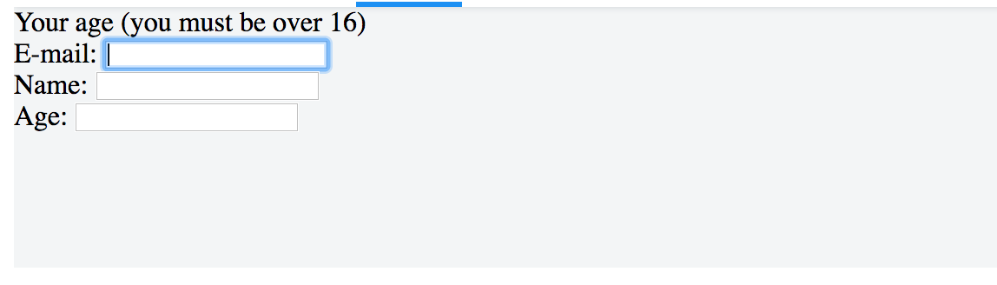
Closure
Notes:
The helpText array defines three helpful hints, each associated with the ID of an input field in the document. The loop cycles through these definitions, hooking up an onfocus event to each one that shows the associated help method.
If you try this code out, you'll see that it doesn't work as expected. No matter what field you focus on, the message about your age will be displayed.
The reason for this is that the functions assigned to onfocus are closures; they consist of the function definition and the captured environment from the setupHelp function's scope. Three closures have been created by the loop, but each one shares the same single environment which has a variable with changing values (item.help). When the onfocus callbacks are executed, accessing item.help at that moment causes this behaviour (indeed, as the value of the variable is only accessed/calculated at runtime), as the loop has run its course by that time, and the item variable object (shared by all three closures) has been left pointing to the last entry in the helpText list.

Slide 92
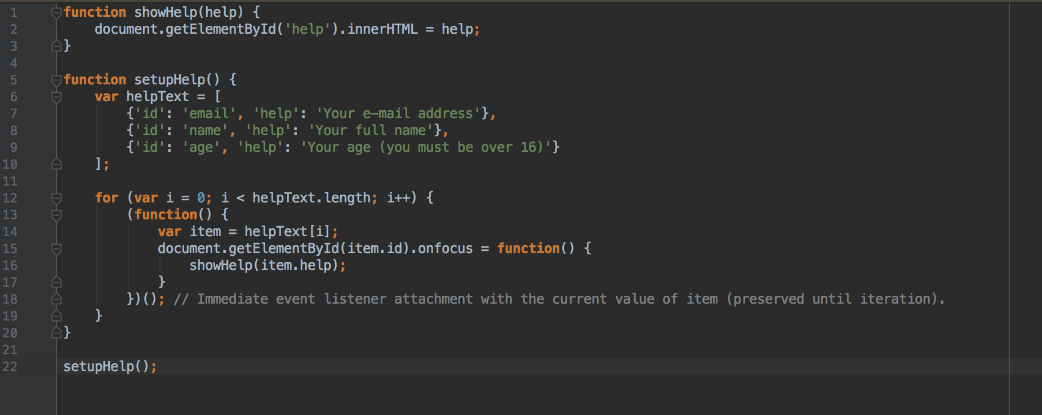
Closure
Notes:
Rather than the callbacks all sharing a single environment, the anonymous closure function creates a new environment for each one in which help refers to the corresponding string from the helpText array.

Slide 93
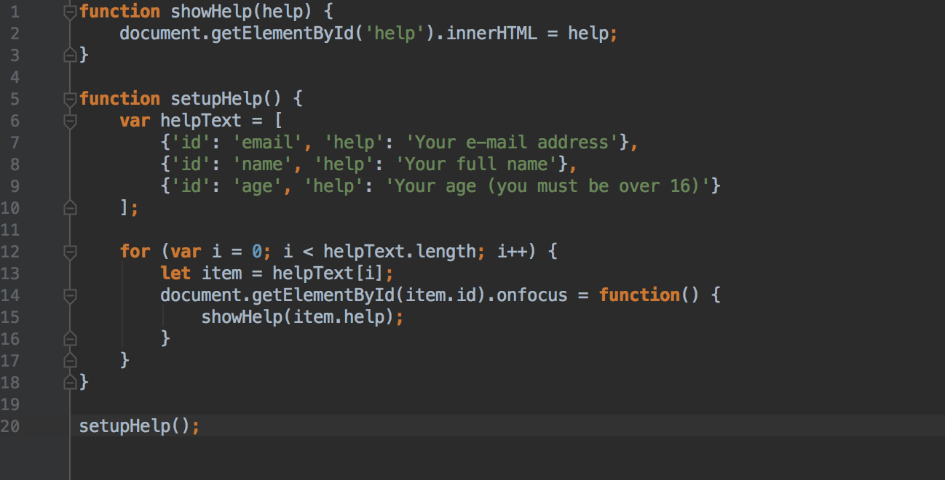
Closure
Notes:
ES6 Fix
In the above case, we used let instead of var, so every closure will bind the every block scoped variable, so it will work perfectly without using any extra closure.

